Slide 1
A quick introduction to INTO
and the eCommerce Evaluation & Consultation for UPS customers
[this deck contains slides that can be included in QBR’s and customer proposals]

Slide 2
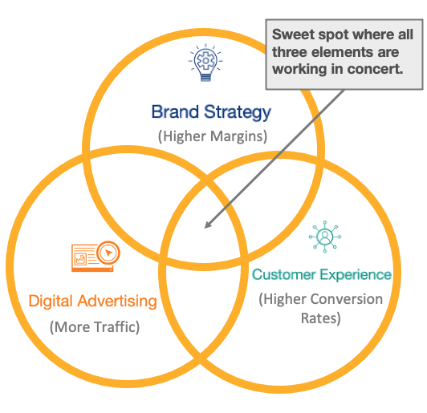
www.into.agency
A Growth Agency
INTO gives companies the tools, strategies, and expertise to achieve sustained eCommerce growth and competitive differentiation.
Notes:
www.into.agency/ups
INTO’s diagnostic process starts with research-driven, One-on-One consultations, designed to identify blind spots and opportunities in a brands eCommerce efforts.
INTO has a proven track record of uniting brand strategy, digital advertising and customer experience improvements to help increase the effectiveness of short and long-range eCommerce investments.

Slide 3
What is a Growth Agency?
Provides companies the tools, strategies, and expertise to achieve sustained eCommerce growth and competitive differentiation.
Which means Curated Research, One-on-One Consultations, and Custom Solutions all designed to identify blind spots and opportunities in a brand’s eCommerce efforts.
We do have a proven track record of providing improvements to help increase the effectiveness of eCommerce investments.
Notes:
www.into.agency/ups

Slide 4
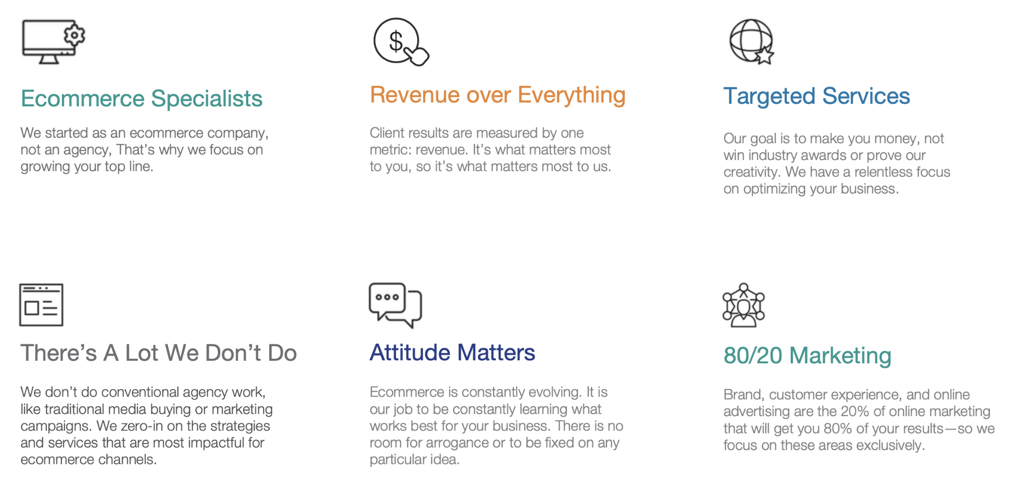
Not the typical agency.
Notes:
Home Reserve (approx. $30M), where we started INTO, spends $7-10k per day -- WHAT TO WORK ON TODAY
not including research, UX, content, etc. - working up and down the buying funnel to find the right mix, at the right time - to get the best possible return

Slide 5
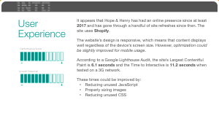
It’s our approach that sets us apart.
INTO Diagnostic
eCommerce Scorecard
Custom Consultation
The INTO diagnostic process subjects a company’s existing eCommerce marketing efforts to an informal, yet thorough evaluation.
We spend ~20 hours researching, benchmarking, and evaluating your online presence.
Based on our research, a scorecard is created, assigning a value and priority in a number of relevant eCommerce categories.
(uniqueness, relevance, brand values, visual identity, user experience, content, navigation, paid search)
Once the results are compiled, INTO shares them with your customer and explains how the research supports their findings.
Companies will be left with a prioritized list of practical, and actionable suggestions for driving eCommerce sales.
(This is not a sales pitch)
The value of the research and consultation is $6-$8,000 – complementary to approved UPS customers (all costs are covered by the UPS | INTO Relationship)

Slide 6
eCommerce Evaluation & Consultation
Helping to identify blindspots and a path forward towards stronger and sustained growth.
Research. The INTO diagnostic process subjects your existing eCommerce marketing efforts to an informal, yet thorough evaluation. They spend ~20 hours researching, benchmarking, and evaluating your online presence.
Scorecard. Based on their research, a scorecard is created, assigning a score ranging from “weak” to “strong” for a number of relevant eCommerce categories.
Consultation. Once the results are compiled, INTO will share them with you and will explain how the research supports our findings.
You will be left with a list of practical, actionable suggestions for improving eCommerce results (i.e. customer acquisition, conversion rates, loyalty, paid search effectiveness, social proof).
The value of the research and consultation is $6-$8,000
How do you perform against competitors and best in class?
What improvements are most important?
*All costs for initial consultation are covered by UPS and INTO - there is no cost to approved UPS customers for the research and scorecard consultation.

Slide 7
Where the rubber meets the road: Results

Slide 8
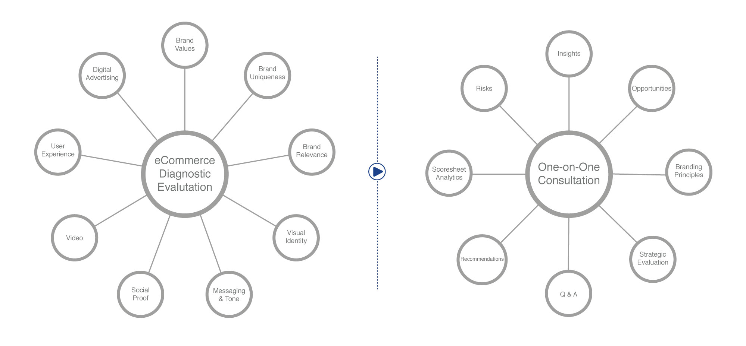
eCommerce Health Check Up.
eCommerce Diagnostic
Comprehensive and data-driven.
Experienced eCommerce Practitioner
Fresh eyes, from borrowed experts.

Slide 9
INTO Service Offerings
Companies hire us to increase revenue, and we do that by re-engineering the three key elements of any ecommerce business.
Brand
Target audience
Research
Architecture
Voice
Improve Margins
Customer Experience
CX mapping
Site navigation
Site design
CX consulting
Increase Conversions
Paid Search
PPC
Digital advertising campaigns
Social, display, video
Increase traffic (quality)
Our approach is more strategic and consultative, rather than tactical.

Slide 10
The Results.

Slide 11
What If Example
What if you could improve your conversion rate? Let’s do the math…
Annual website traffic 2,000,000
Conversion rate improvement (est.) x .5%
Additional orders resulting from conversion rate improvement 10,000
Estimated AOV (average order value) x $75
New annual revenue (orders x AOV) $750,000
Profit margin (est.) x 25%
New annual profit (est.) $187,500
NOT a promise, but a concrete example of the kinds of impact these changes often have.
Site traffic source: SimilarWeb

Slide 12
NOT a promise, but a concrete example of the kinds of impact these changes often have.

Slide 13
